Slide 1
Connecting with Blue
USD 409 Atchison Public Schools
7/1/2021

Slide 2
Agenda
03
05
08
10
Welcome
Network
Benefits
Online resources

Slide 3
Welcome

Slide 4
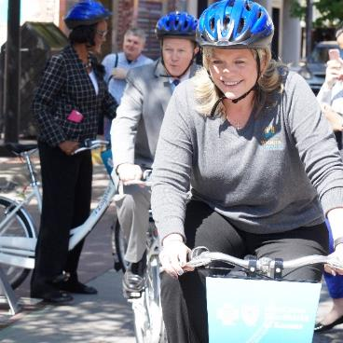
The Blue connection
Improving life through:
Commitment
Compassion
Community
Kansans Serving Kansans for over 75 Years
Improving life through:
Commitment
Compassion
Community
Notes:
At Blue Cross, we are constantly striving to improve the life of Kansans through Commitment, Compassion and Community. Having served Kansans for over 75 years, we're proud of our Kansas heritage and local support in Wichita and are working to turn compassion into action by empowering members to live meaningful, productive lives. We are leading the way to better health care, while focusing on what matters most to our members.
We're committed to improving the health and wellbeing of all Kansans. It's important to us.

Slide 5
We’ve got you covered
In Kansas
99%
100%
1 in 3
of physicians in-network
of hospitals in-network
covered in Kansas

Slide 6
We’ve got you covered
Outside of Kansas
92%
96%
of physicians in-network
of hospitals in-network

Slide 7
We’ve got you covered
Around the world
Access to doctors and hospitals in more than 200 countries and territories around the world

Slide 8
Your benefits

Slide 9
Group health benefits
 | Option 1 (Traditional PPO) | Option 2 (Traditional PPO) | Option 3 (HSA-qualified)
In-network deductible | $1,500 individual / $3,000 family | $2,500 individual / $5,000 family | $5,000 individual / $10,000 family
In-network coinsurance | 80%/20% up to Out of Pocket | 80%/20% up to Out of Pocket | 100%
Out-of-pocket maximum | $5,000 individual / $10,000 family | $6,350 individual / $12,700 family | $6,350 individual / $12,700 family
Office visit – primary/specialist | $35 / $70 Copay | $35 / $70 Copay | 100% after deductible
Routine care for adult/child/baby | 100% | 100% | 100%
Retail pharmacy | Generic: $15 copay Formulary: $50 copay Non-formulary: $75 copay Specialty: $150/20% up to $250 | Generic: $15 copay Formulary: $50 copay Non-formulary: $75 copay Specialty: $150/20% up to $250 | Generic: $15 copay Formulary: $50 copay Non-formulary: $75 copay Specialty: $150/20% up to $250
Mail-order pharmacy | Generic: $37.50 copay Formulary: $125 copay Non-formulary: $187.50 copay | Generic: $37.50 copay Formulary: $125 copay Non-formulary: $187.50 copay | Deductible plus Generic: $37.50 copay Formulary: $125 copay Non-formulary: $187.50 copay

Slide 10
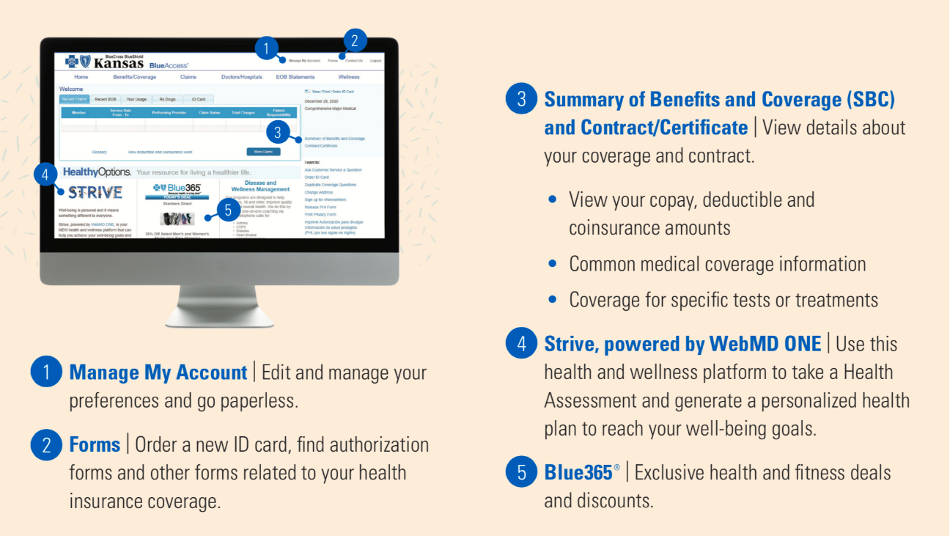
Member portal | BlueAccess
Notes:
Our secure online member portal allows you to:
View benefits, including eligibility and deductible/coinsurance information
Check your claims
View, download and monitor medical expenses
through your Explanation of Benefits (EOBs)
View, download or print your digital ID card

Slide 11
A faster, easier way to see a doctor
Telemedicine connects you with a doctor anytime, anywhere
Consult with a doctor by computer, tablet or phone
Affordable, easy and convenient – available 24/7/365
A choice of trusted, U.S. board-certified doctors
No appointment, no waiting
Prescriptions as needed
bcbsks.com/telemedicine

Slide 12
HealthyOptions
Your resource for living a healthier life
Hands-on health tools
Disease management :: NEW maternity program
Case management
Wellness management
Workplace wellness

Slide 13
Powered by WebMD ONE, can help you reach your well-being goals and be the best “you”.
Health assessment
Daily habits
Health coaching
App connection center and tracker
Enroll via your BlueAccess account
Demo

Slide 14
Prime Therapeutics
myprime.com
Pharmacy benefit manager
Integrated benefits
Copay max
Formulary/medication list
Specialty medication
Mail service/home delivery
Prior authorizations

Slide 15
GeoBlue®
bcbsks.com/travel
Easy, affordable travel medical insurance
Hospitalization, doctor visits and prescription coverage
Cashless, paperless service – GeoBlue direct bills for care
Emergency medical evacuation for urgent, unexpected care
An elite provider network
Online tools, a free app and 24/7/365 concierge support to help schedule appointments

Slide 16
Instant information. Always on.
bcbsks.com
BlueAccess®
Provider directory
Blue365®
Wellness media library

Slide 17
Finding a network provider is easy!
Search by name, specialty or location on our website, through our convenient online Doctor/Hospital Finder.
You’ll have access to our cost transparency tool so you can compare costs before going to the doctor.
bcbsks.com/find-a-doctor

Slide 18
Glossary
Copayment or copay
A copayment is the set dollar amount you pay (for example, the $20 you pay when you check out at the doctor’s office) for medical services or prescription drugs at the time you receive them.
Deductible
A deductible is the set dollar amount you pay toward covered medical services each benefit period before Blue Cross and Blue Shield of Kansas starts paying toward those services.
Coinsurance
Coinsurance is your share of the cost of a covered medical service after you’ve met your deductible for your benefit period.
Out-of-pocket maximum
The maximum dollar amount you pay for covered services in a benefit period before Blue Cross pays 100% of covered services. It includes your deductible, coinsurance and copayments.
In-network/out-of-network providers
In-network providers are health care providers and facilities that contract with Blue Cross or participate in the BlueCard program. You may pay less if you see an in-network provider.
Allowed amount
The allowed amount is the maximum payment Blue Cross will pay for a covered health care service. If a provider charges more than the allowed amount, you may have to pay the difference.
Explanation of Benefits (EOB)
Members receive an EOB after a visit to a doctor, healthcare provider, pharmacy or facility. An EOB lists details of the medical service received including date, amounts paid by Blue Cross, and any cost the member may owe.

Slide 19
Customer Service Center
1-800-432-3990
csc@bcbsks.com

